Slide 1
Toronto Clustering of Indian Restaurants

Slide 2
Introduction
For this capstone project, I have taken a scenario where a businessman wants to start a Indian restaurant in Toronto City. The business would like to find the best area to start this new restaurant such that it has the least competition from other Indian Restaurants in the neighbourhood. I design a project to help achieve this by finding places that are viable and places with have the most competition in the City of Toronto for Indian Restaurants.

Slide 3
Data Extraction and Cleaning
List of neighbourhoodsusing postcodes taken from https://en.wikipedia.org/wiki/List_of_postal_codes_of_Canada:_M
Geographicdata for the respective neighbourhoodswhich is taken from https://cocl.us/Geospatial_data
Foursquare API venue search for Indian Restaurants in Toronto Region

Slide 4
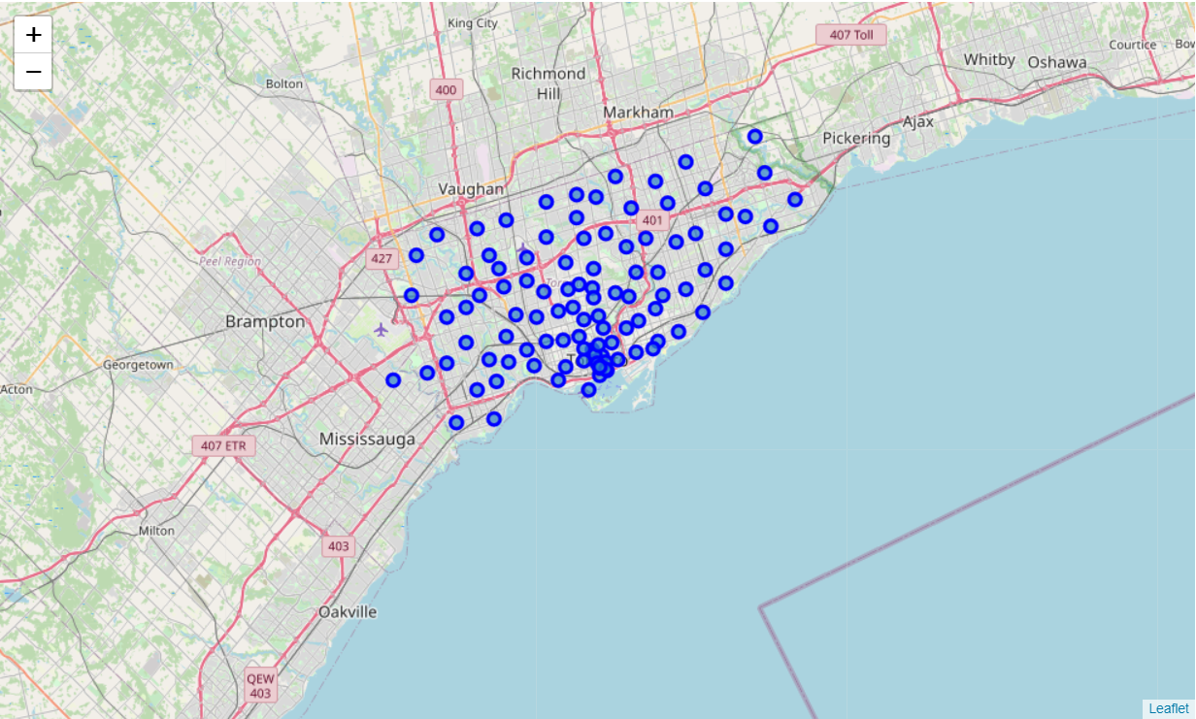
Toronto Neighbourhoods Clustering

Slide 5
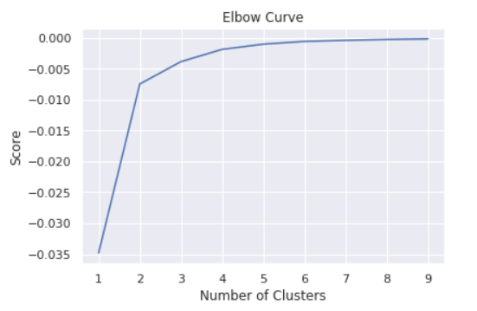
K-means Clustering Elbow Curve

Slide 6
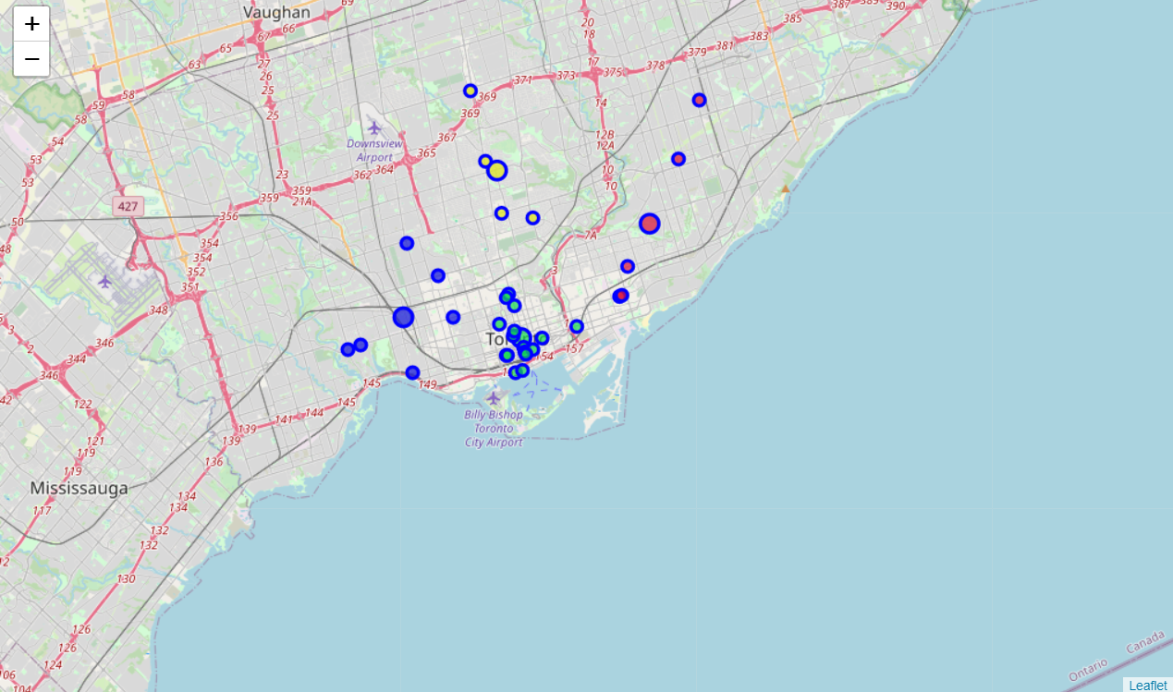
Indian Restaurants Clustered based on Neghboorhood

Slide 7
Conclusion and Future Directions
Able to determine the ideal neighbourhoods to start an Indian restaurant taking only number of restaurants into consideration.
Other factors such as population density, income of people, etc. can be used to improve the accuracy of the model.
Clusters combine multiple neighbourhoods to form 1 cluster, so cannot identify the individual neighbourhood that’s ideal.

